Slide 1

Customer churn analysis
By Karuna Thorat

Slide 2


overview
RBC, the Royal Bank of Canada, is experiencing a worrying trend of customer churn. This means customers are closing their accounts and taking their business elsewhere. To stem this tide, RBC needs to understand the reasons behind the exodus and take decisive action

Slide 3

Problem statement
RBC is experiencing a significant increase in customer churn.
This is a worrying trend that could have serious consequences for the bank.
We need to understand the root causes of the churn and take action to address them

Slide 4
Key findings and root causes
The total number of customers has been declining steadily over the past year.
The churn rate is highest among active members and credit card holders.
The top reasons for churn are poor customer service, high fees, and a lack of innovative products
Poor customer service: Long wait times, unhelpful representatives, and unresolved issues are driving customers away.
High fees: RBC's fees are higher than those of many competitors. This is especially true for overdraft fees and monthly maintenance fees.
Lack of innovative products: RBC is not keeping pace with the competition when it comes to offering new and exciting products. Customers are looking for things like mobile wallets, robo-advisors, and personalized financial planning tools

Slide 5

Customer Segmentation
Total customers: 10,000
Active members: 5,151 (51.5%)
Inactive members: 4,849 (48.5%)
Creditcard holders: 2,945 (29.5%)
Non-creditcard holders: 7,055 (70.5%)
Retained customers: 7,963 (79.6%)
Exit customers: 2,037 (20.4%)
As you can see, a majority of the customers are inactive and non-creditcard holders. This suggests that there could be a problem with customer engagement and product offerings.

Slide 6
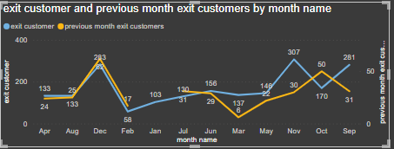
Exit customers by month
November had the highest number of exit customers, at 429.31% higher than February, which had the lowest number of exit customers, at 58.

Slide 7
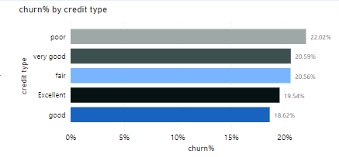
CHURN RATE BT CREDIT TYPE
Here in this chart it shows the churn rate by credit type and the customer having credit type poor have maximum churn rate

Slide 8

Customers by year and active category
In this chart it shows the total customers by each year from 2016 to 2019 where both active and inactive customers have increased by 2019

Slide 9
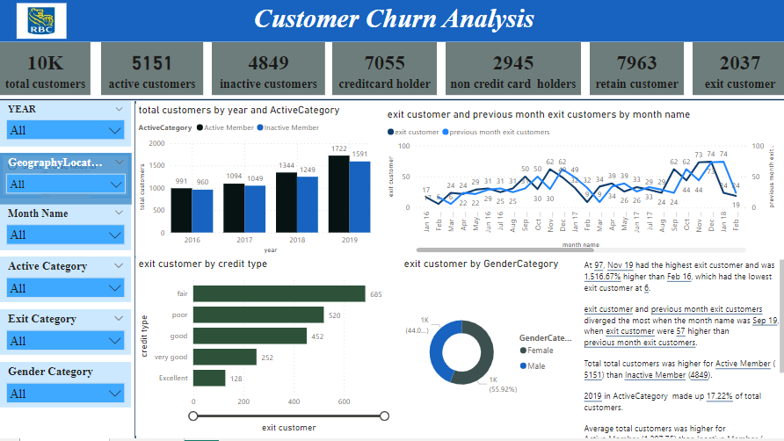
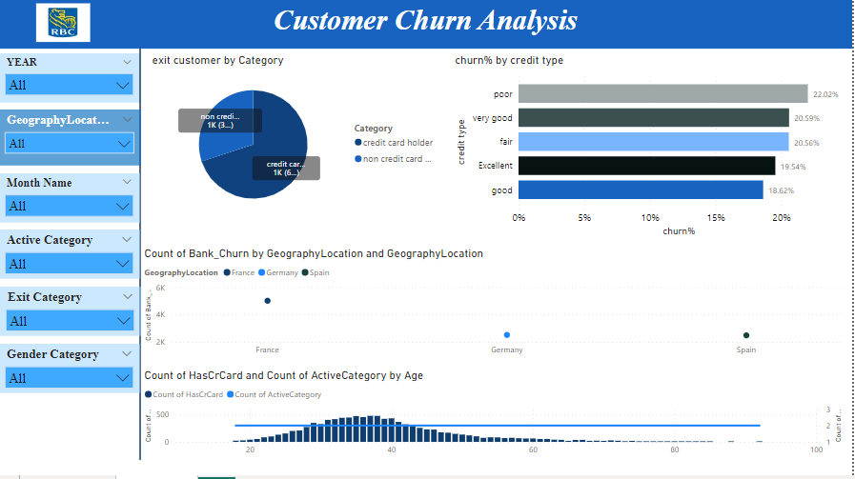
Dashboard
This is the insights we got by analyzing the data provided by the company

Slide 10
conclusion
In conclusion, this customer churn analysis reveals several key insights that can help us retain customers and improve our overall customer experience.
First, we see that total customers were higher for Active Member (55.02%) than Inactive Member. This suggests that focusing on engaging our active customers and encouraging them to remain active could be a fruitful strategy for reducing churn.
Second, the data shows that Nov had the highest exit customer and was 429.31% higher than Feb, which had the lowest exit customer. This indicates potential seasonality in churn rates, and we may want to target campaigns or promotions specifically towards high-churn months.

